Slide 1
Lecture 6 Roots: Bracketing Methods

Slide 2
Chapter Objectives
Understanding what roots problems are and where they occur in engineering and science.
Knowing how to determine a root graphically.
Understanding the incremental search method and its shortcomings.
Knowing how to solve a roots problem with the bisection method.
Understanding false position.

Slide 3
Roots
“Roots” problems occur when some function f can be written in terms of one or more dependent variables x, where the solutions to f(x)=0 yields the solution to the problem.
These problems often occur when a design problem presents an implicit equation for a required parameter.

Slide 4
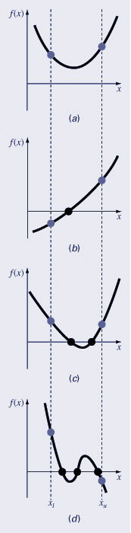
Graphical Methods
A simple method for obtaining the estimate of the root of the equation f(x)=0 is to make a plot of the function and observe where it crosses the x-axis.
Graphing the function can also indicate where roots may be and where some root-finding methods may fail:
Same sign, no roots
Different sign, one root
Same sign, two roots
Different sign, three roots

Slide 5
A Mathematical Property
Well-known Mathematical Property:
If a function f(x) is continuous on the interval [a..b] and sign of f(a) ≠ sign of f(b), then
There is a value c ∈ [a..b] such that: f(c) = 0 I.e., there is a root c in the interval [a..b]

Slide 6
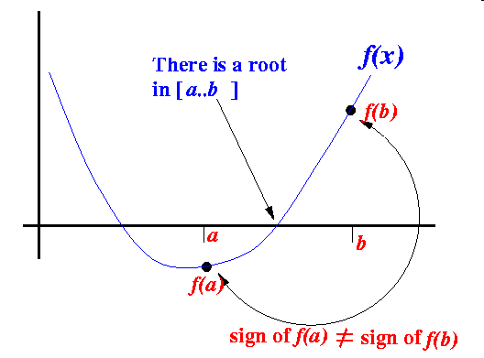
A Mathematical Property (cont.)
Example:

Slide 7
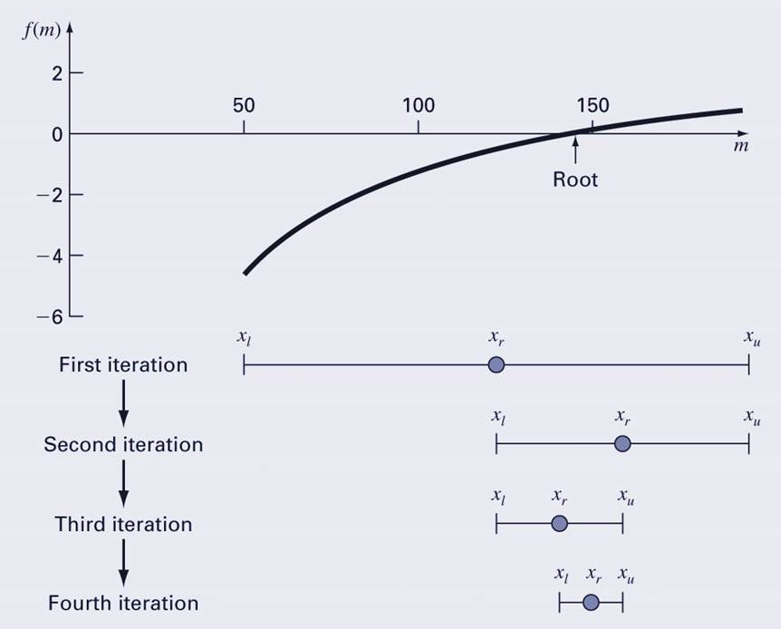
Bisection
The bisection method is a variation of the incremental search method in which the interval is always divided in half.
If a function changes sign over an interval, the function value at the midpoint is evaluated.
The location of the root is then determined as lying within the subinterval where the sign change occurs.
The absolute error is reduced by a factor of 2 for each iteration.

Slide 8
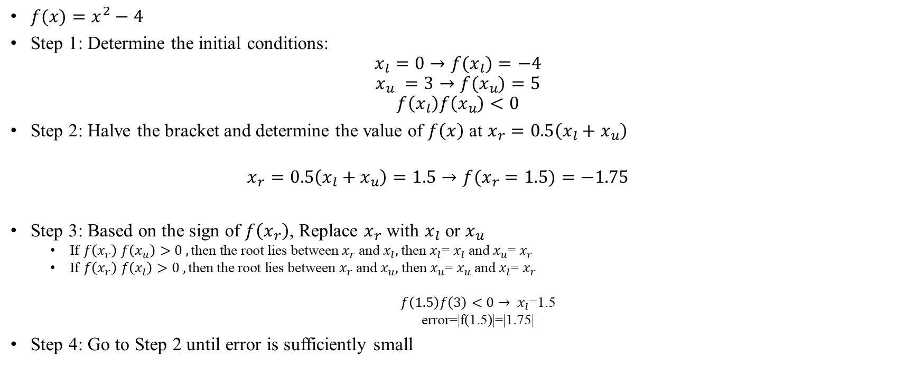
Bisection: Example
$f(x)=x^{2}−4$
Step 1: Determine the initial conditions:
$$x_{l}=0→f(x_{l})=−4$$
$$x_{u} =3→f(x_{u})=5$$
$$f\left(x_{l}\right)f\left(x_{u}\right)<0$$
Step 2: Halve the bracket and determine the value of $f\left(x\right)$at $x_{r}=0.5\left(x_{l}+x_{u}\right)$
$$x_{r}=0.5\left(x_{l}+x_{u}\right)=1.5→f(x_{r}=1.5)=−1.75$$
Step 3: Based on the sign of $f\left(x_{r}\right)$, Replace $x_{r}$ with $x_{l}$ or $x_{u}$
If $f\left(x_{r}\right)$ $f\left(x_{u}\right)>0 ,\text{then} \text{the} \text{root} \text{lies} \text{between}$ $x_{r}$ and $x_{l},$then $x_{l}$= $x_{l}$ and $x_{u}$= $x_{r}$
If $f\left(x_{r}\right)$ $f\left(x_{l}\right)>0 ,\text{then} \text{the} \text{root} \text{lies} \text{between}$ $x_{r}$ and $x_{u},$then $x_{u}$= $x_{u}$ and $x_{l}$= $x_{r}$
$f\left(1.5\right)f\left(3\right)<0→ x_{l}$=1.5
error=|f(1.5)|=|1.75|
Step 4: Go to Step 2 until error is sufficiently small

Slide 9

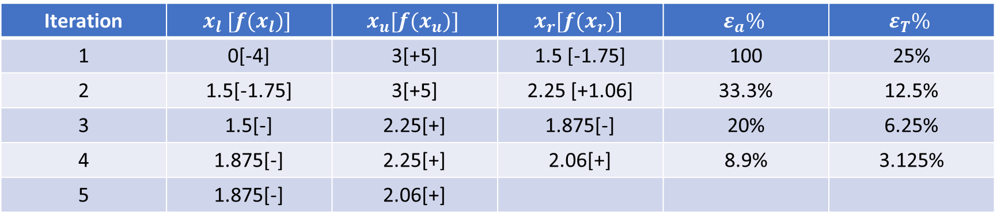
Bisection Example
Iteration | $$x_{l} [f{(x}_{l})]$$ | $$x_{u}[f{(x}_{u})]$$ | $$x_{r}[f{(x}_{r})]$$ | $$ε_{a}\%$$ | $$ε_{T}\%$$
1 | 0[-4] | 3[+5] | 1.5 [-1.75] | 100 | 25%
2 | 1.5[-1.75] | 3[+5] | 2.25 [+1.06] | 33.3% | 12.5%
3 | 1.5[-] | 2.25[+] | 1.875[-] | 20% | 6.25%
4 | 1.875[-] | 2.25[+] | 2.06[+] | 8.9% | 3.125%
5 | 1.875[-] | 2.06[+]

Slide 10
Bisection Error
The absolute error of the bisection method is solely dependent on the absolute error at the start of the process (the space between the two guesses) and the number of iterations:
The required number of iterations to obtain a particular absolute error can be calculated based on the initial guesses:

Slide 11
False Position
The false position method is another bracketing method.
It determines the next guess not by splitting the bracket in half but by connecting the endpoints with a straight line and determining the location of the intercept of the straight line (x_{r}).
The value of x_{r} then replaces whichever of the two initial guesses yields a function value with the same sign as f(x_{r}).

Slide 12
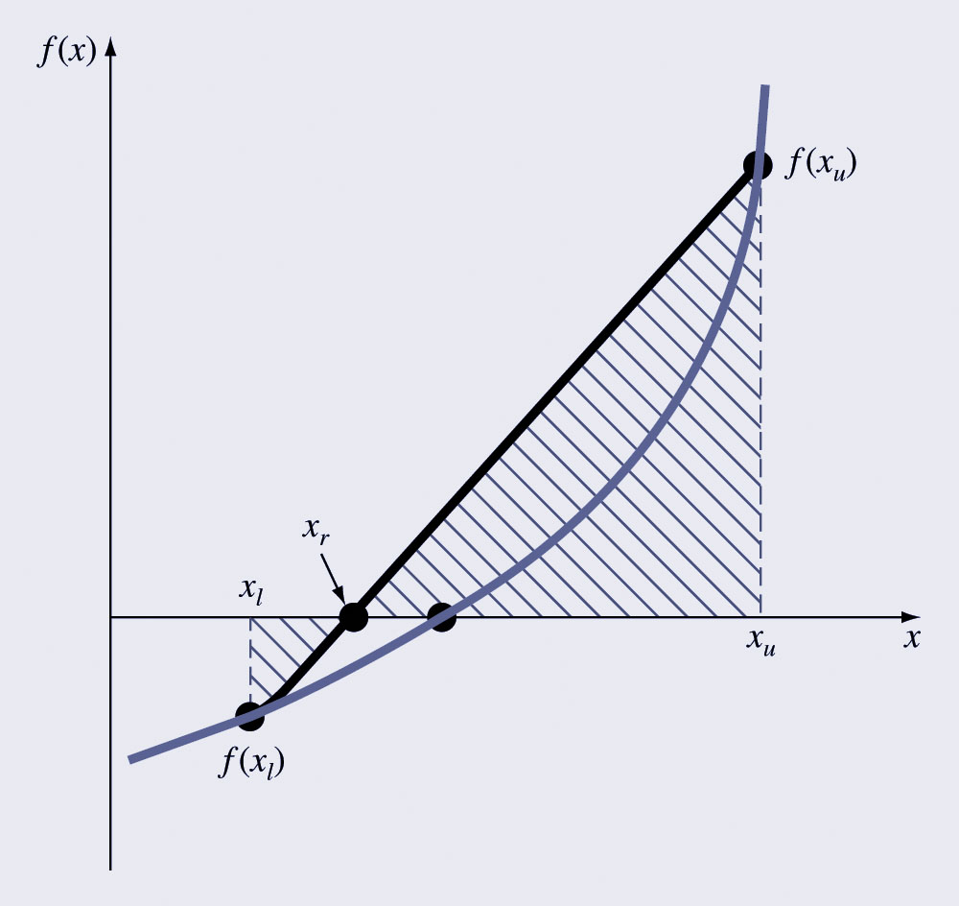
False Position Illustration

Slide 13
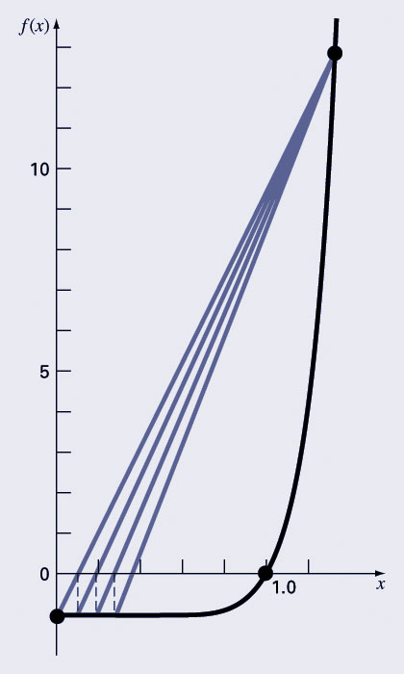
Bisection vs. False Position
Bisection does not take into account the shape of the function; this can be good or bad depending on the function!
Bad:

Slide 14
Bisection
False Position

Slide 15

False Position: Example
$f(x)=x^{2}−4$
Step 1: Determine the initial conditions:
$$x_{l}=0→f(x_{l})=−4$$
$$x_{u} =3→f(x_{u})=5$$
$$f\left(x_{l}\right)f\left(x_{u}\right)<0$$
Step 2: Estimate the roots
$$x_{r}=x_{u}−\frac{f\left(x_{u}\right)\left(x_{l}−x_{u}\right)}{f\left(x_{l}\right)−f\left(x_{u}\right)}→x_{r}=3−\frac{5\left(0−3\right)}{5−\left(−4\right)}=1.3333$$
error=|f(1.33)|=| 2.2222 |
$x_{l}$ = $x_{r}$
Step 4: Go to Step 2 until error is sufficiently small

Slide 16
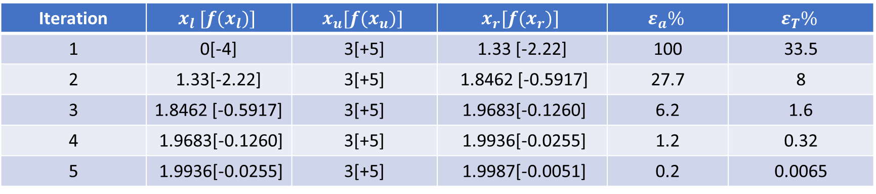
False Position Example
Iteration | $$x_{l} [f{(x}_{l})]$$ | $$x_{u}[f{(x}_{u})]$$ | $$x_{r}[f{(x}_{r})]$$ | $$ε_{a}\%$$ | $$ε_{T}\%$$
1 | 0[-4] | 3[+5] | 1.33 [-2.22] | 100 | 33.5
2 | 1.33[-2.22] | 3[+5] | 1.8462 [-0.5917] | 27.7 | 8
3 | 1.8462 [-0.5917] | 3[+5] | 1.9683[-0.1260] | 6.2 | 1.6
4 | 1.9683[-0.1260] | 3[+5] | 1.9936[-0.0255] | 1.2 | 0.32
5 | 1.9936[-0.0255] | 3[+5] | 1.9987[-0.0051] | 0.2 | 0.0065

Slide 17
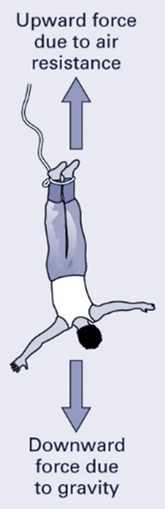
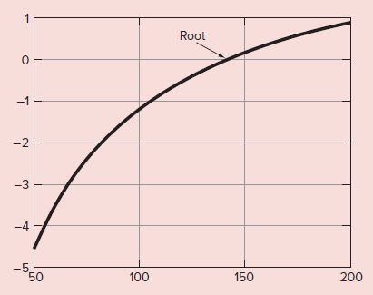
False Position and Bisection Example
Use the bisection and false position approach to determine the mass of the bungee jumper with a drag coefficient of 0.25 kg/m to have a velocity of 36 m/s after 4 s of free fall. Note: The acceleration of gravity is 9.81 m/s².

Slide 18
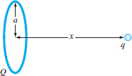
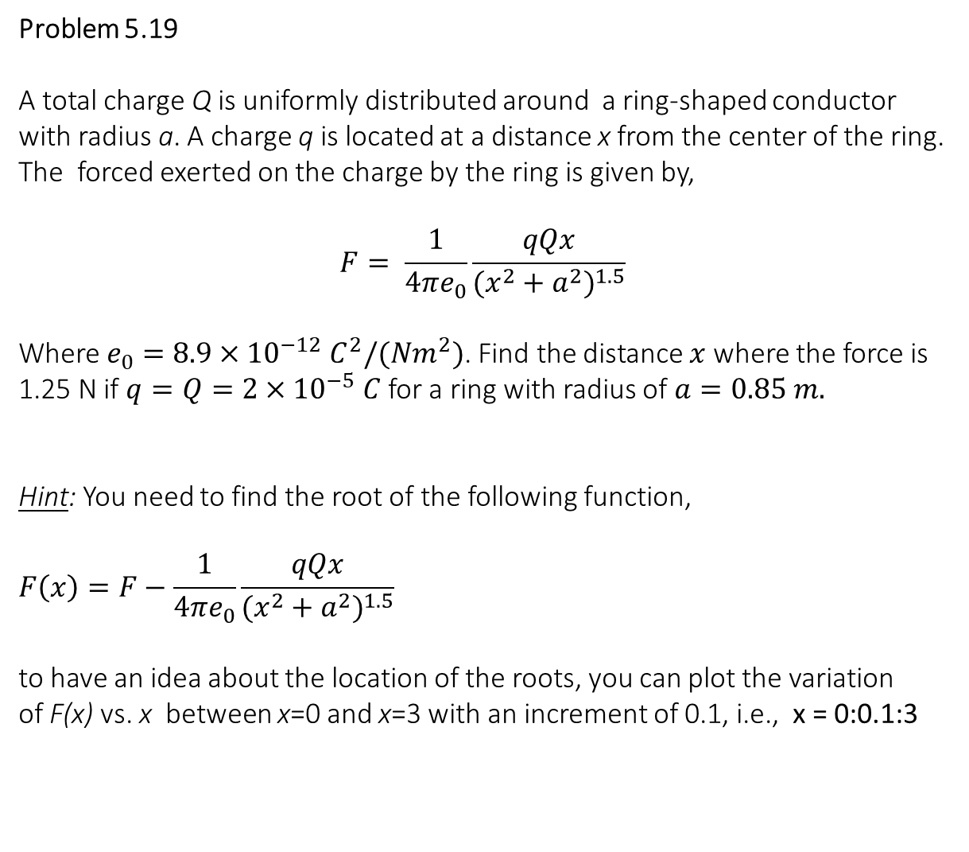
Problem 5.19
A total charge Q is uniformly distributed around a ring-shaped conductor with radius a. A charge q is located at a distance x from the center of the ring. The forced exerted on the charge by the ring is given by,
$$F= \frac{1}{4πe_{0}}\frac{qQx}{{(x^{2}+a^{2})}^{1.5}}$$
Where $e_{0}=8.9×{10}^{−12} C^{2}/(Nm^{2})$. Find the distance $x$ where the force is 1.25 N if $q=Q=2×{10}^{−5} C$ for a ring with radius of $a=0.85 m.$
Hint: You need to find the root of the following function,
$$F\left(x\right)=F−\frac{1}{4πe_{0}}\frac{qQx}{{(x^{2}+a^{2})}^{1.5}}$$
to have an idea about the location of the roots, you can plot the variation
of F(x) vs. x between x=0 and x=3 with an increment of 0.1, i.e., x = 0:0.1:3

